Slide 1
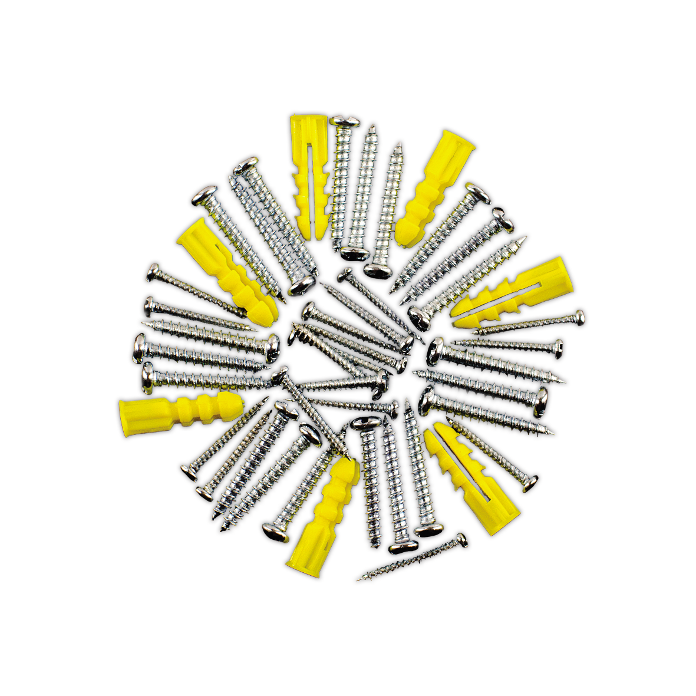
Microservices from the ground up
Systems Engineering

Slide 2
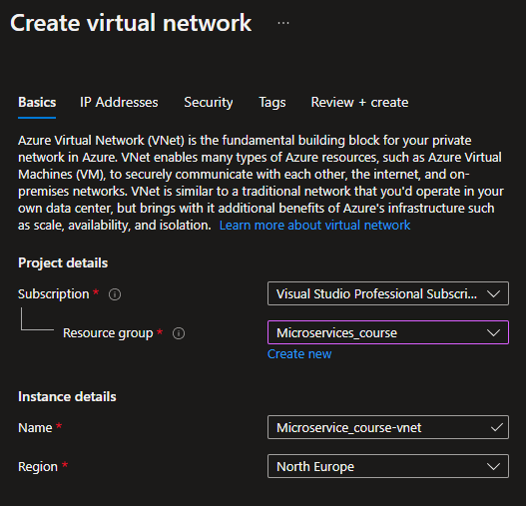
Terraform – Instead of using the GUI

Slide 3
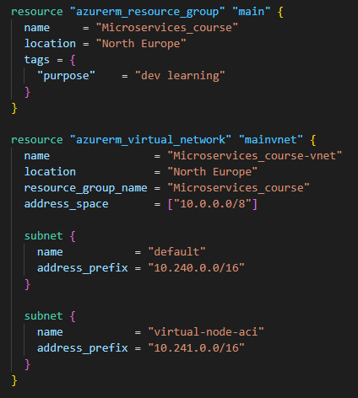
Terraform – Instead of using the GUI

Slide 4
Terraform – Instead of using the GUI

Slide 5
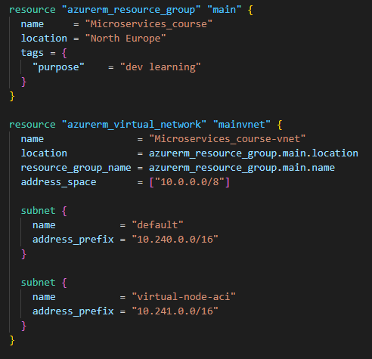
Terraform – Instead of using the GUI

Slide 6
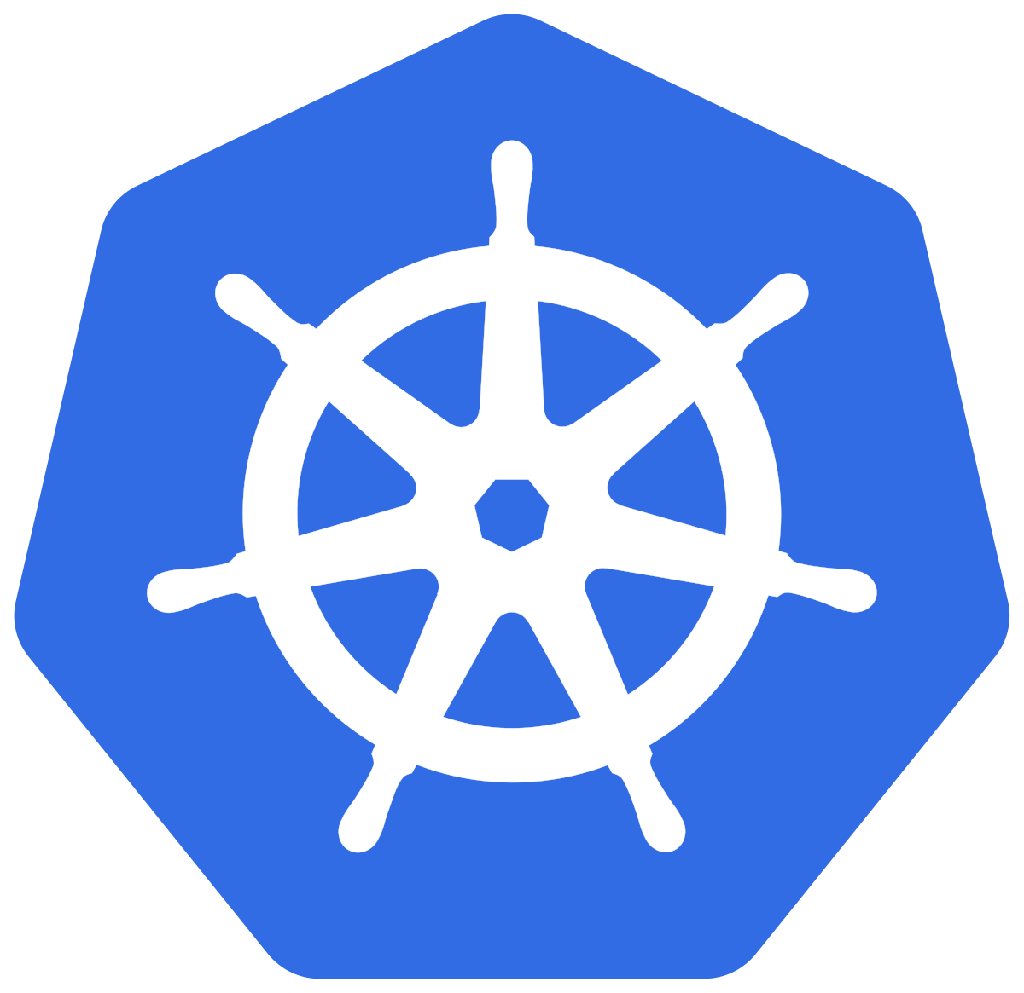
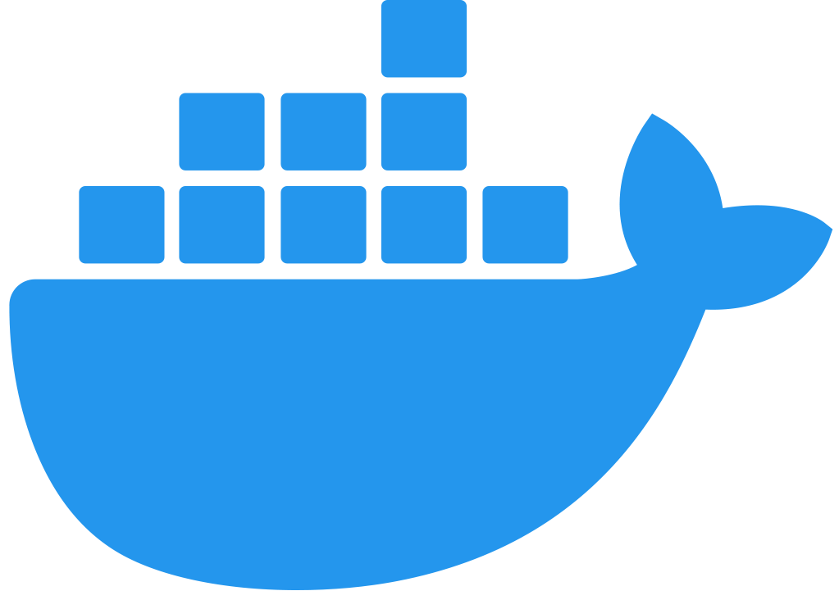
Kubernetes cluster
Worker
Pod
Api
Service
Worker
Pod
HTTP
Pod
Client
AQMP
Worker
AQMP
Pod
RabbitMQ

